Slide 1
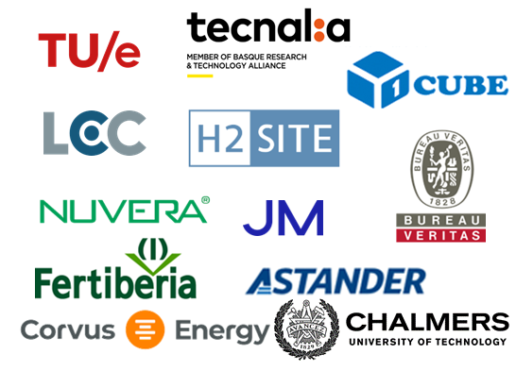
PROJECT OVERVIEW
ANGELA MARY THOMAS
angela.thomas@tecnalia.com
Notes:
Add membrane group

Slide 2
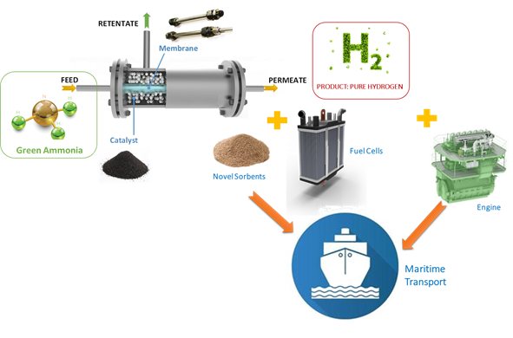
APOLO PROJECT CONTRACT
Contract number: 101138466
Type of Action: HORIZON Research - Innovation Action (RIA)
Starting date: 1st of January 2024
Duration: 48 months
Project funding: € 7,511,266.25
Granting Authority European Climate, Infrastructure and Environment Executive Agency (CINEA)

Slide 3
OUTLINE
Objectives and Concept
Key Exploitable and Expected Results
Participants and Consortium Synergies
Methodology and Execution
Expected Outcomes

Slide 4
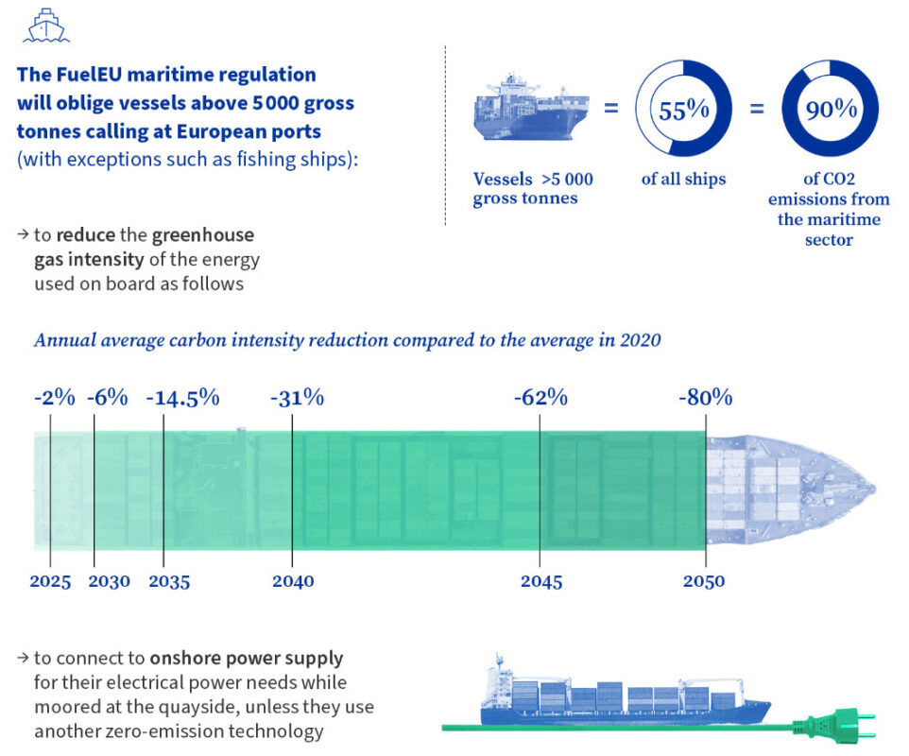
OBJECTIVES AND CONCEPT
Provide breakthrough in the development of advanced power conversion technologies in maritime sector.
Shipping industry responsible for ~ 13% of total CO₂ emissions from the EU transport sector in 2019 according to EEA
July 2021
Fit for 55
Cut greenhouse gas emission by 55% by 2030
Shipping Investments grew in alternate fuels
Ammonia
FuelEU Maritime
March 2023
Consilium (europa.eu)
Notes:
In July 2021, the EC adopted the ‘Fit for 55’ legislation package, EU’s most ambitious initiative to cut GHG emission
by 55% by 2030. As part of it, the EC introduced the EU Ship Emissions Trading System (ETS) as an extension of
the existing EU ETS. On the 23rd of March 2023, the EU Parliament agreed on FuelEU Maritime – a new EU
regulation ensuring that the greenhouse gas intensity of fuels used by the shipping sector will gradually decrease over
time, by 2% in 2025 to as much as 80% by 2050.

Slide 5
OBJECTIVES AND CONCEPT
Smart combination of an innovative onboard Ammonia cracking technology, a Catalytic Membrane Reactor (CMR) with
An advanced Fuel cell running on pure hydrogen (Prototype 1/ KER1)
A novel Ammonia Engine running on an ammonia/hydrogen blend (Prototype 2/ KER2)
Develop a full LCA, LCC, sLCA and Health and Safety Analysis (HSE) of APOLO.
Pave the way for future exploitation of APOLO Key Exploitable results.
Promote the dissemination and communication of APOLO’s results and expand its impact.
Notes:
In July 2021, the EC adopted the ‘Fit for 55’ legislation package, EU’s most ambitious initiative to cut GHG emission
by 55% by 2030. As part of it, the EC introduced the EU Ship Emissions Trading System (ETS) as an extension of
the existing EU ETS. On the 23rd of March 2023, the EU Parliament agreed on FuelEU Maritime – a new EU
regulation ensuring that the greenhouse gas intensity of fuels used by the shipping sector will gradually decrease over
time, by 2% in 2025 to as much as 80% by 2050.

Slide 6
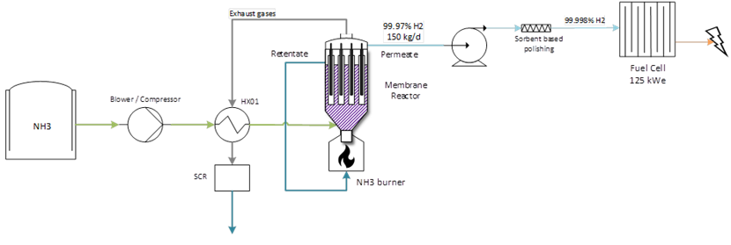
KEY EXPLOITABLE AND EXPECTED RESULTS
KER1: Advanced power conversion system based on the combination of high purity ammonia cracker (>99.998%, 150 kg_{H2}/day) and a high efficiency PEM fuel cell (Prototype 1)
ER1: High purity CMR with highly selective membranes, catalyst and sorbents.
ER2: Innovative environmentally friendly catalyst materials for ammonia cracking.
ER3: Innovative Pd membranes and hollow fiber supports for selective H₂ separation.
ER4: Novel sorbents for polishing the H₂ recovered by the membranes.
ER5: BoP for advanced PEM FCs coupled with ammonia cracker
Main end-user: Ships owners or operators.
Value proposition: Advanced power conversion system based on the combination of ammonia cracker and a high efficiency PEM fuel cell with an overall efficiency of 51-54%

Slide 7
KEY EXPLOITABLE AND EXPECTED RESULTS
KER2: Advanced power conversion system based on the combination of a low purity ammonia cracker (>98%, 50 kg_{H2}/day, 30% H₂ in NH₃ blend) and a high efficiency 4 stroke engine (Prototype 2)
ER2: Innovative environmentally friendly catalyst materials for ammonia cracking.
ER3: Innovative Pd membranes and hollow fiber supports for selective H₂ separation
ER6: Low purity CMR with highly selective membranes and catalyst
ER7: Advanced ammonia combustion engine coupled with catalytic converter
Main end-user: Ships owners or operators.
Value proposition: Advanced power conversion system based on the combination of ammonia cracker and a high efficiency engine with an overall efficiency of >45%

Slide 8
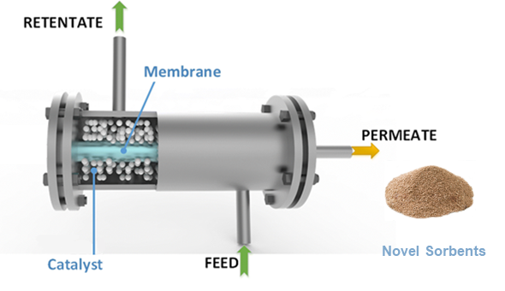
KEY EXPLOITABLE AND EXPECTED RESULTS
Catalytic Membrane Reactors
Catalyst (JM):
Innovative and environmentally friendly catalyst with low Ru content
Aims for high conversion at low catalyst loading at lower temperatures than SoA.
Membranes (H2SITE, TEC, TUE):
Innovative Pd based membranes for selective separation of H₂ during production process.
Minimum H₂ / N₂ selectivity targeted – 100,000.
Sorbents for prototype 1 (TUE, JM):
Novel sorbents for polishing the H₂ recovered by the membranes.
Modified zeolite materials with <12% Cu with adsorption capacities of > 3 mmol_{NH3}/g_{sorbent.}
Benchmarking with other solid acid adsorbents.

Slide 9
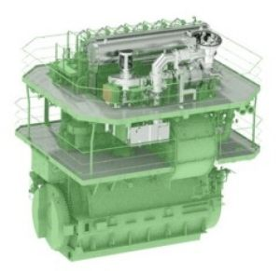
KEY EXPLOITABLE AND EXPECTED RESULTS
Fuel Cells
Internal Combustion Engine
2 commercially available Fuel Cell Systems using hydrogen from ammonia cracking with a power output of 125kW.
2 FCs with two different H₂ inlet pressure ranges
Low H₂ inlet pressure (3-8 bar) – NUVERA
High H₂ inlet pressure (9-15 bar) – CORVUS
High-speed internal combustion engine with the ammonia cracker for marine applications at TRL 5 with an engine output power of 125 kW.
Selective Catalytic Reduction system (SCR) based on Cu, Fe and V for the removal of NOx emissions from the exhaust of the novel engine.

Slide 10
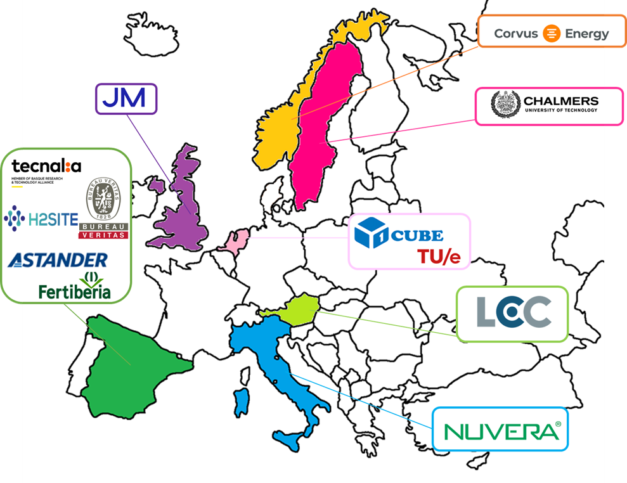
PARTICIPANTS AND CONSORTIUM SYNERGIES
13 consortium partners from all over Europe!
9 SME/IND + 4 RTD partners
67 %Industrial participation

Slide 11
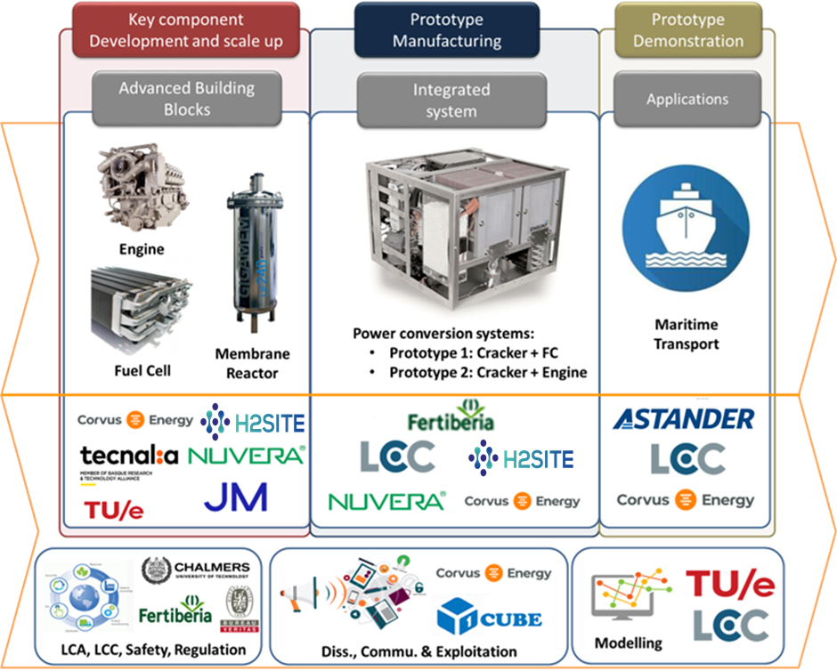
PARTICIPANTS AND CONSORTIUM SYNERGIES
Partner | Role
TEC | Membrane development and project coordination
TUE | Reactor development, lab testing and process design
JM | Catalyst development for membrane reactor
1CUBE | Dissemination & communication and support to project coordination
H2SITE | Onboard conversion technology scaleup (membrane reactor)
FER, FERSA | Ammonia supply, system testing and integration
CHALMERS | LCA & LCC, regulation and exploitation
CORVUS, NUVERA | FC development & scale up
LEC | Engine development
ASTANDER | Preliminary design of power train for the ships
BV | Develop partial amendments on EU and IMO regulations on the use of ammonia

Slide 12
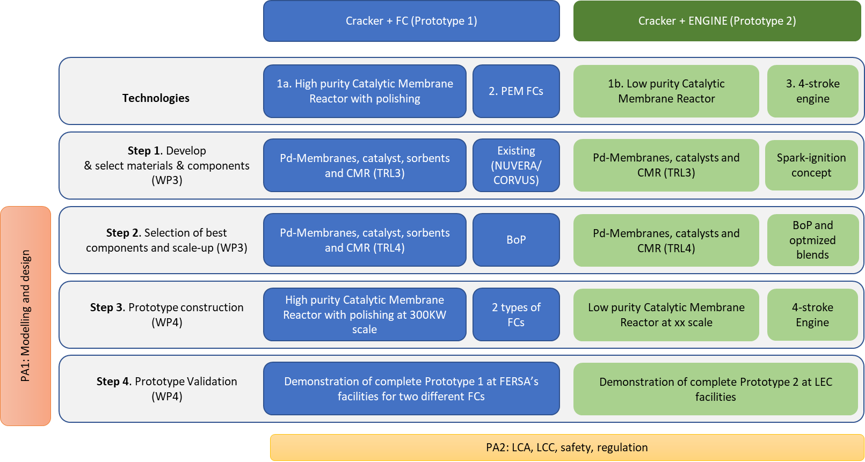
METHODOLOGY AND EXECUTION

Slide 13
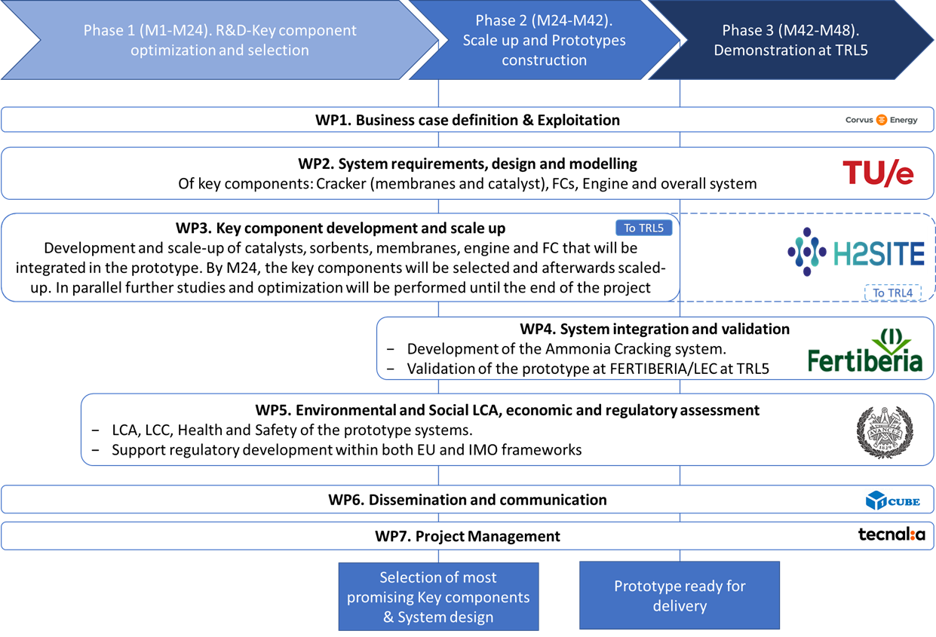
METHODOLOGY AND EXECUTION

Slide 14
EXPECTED OUTCOMES
APOLO will work to tackle the challenges of power conversion from ammonia and develop a flexible and efficient ammonia cracking technology coupled with FCs and engines to fully decarbonize the maritime sector.
Full value chain covers from the synthesis of Ammonia (FER) to the shipbuilder (ASTANDER) going through all key component manufacturers reinforce the energy independence of Europe.
The technologies developed are modular and easily scalable. The prototypes will have a power output of 125kW, becoming the previous step before jumping to MW scale.
The results from the LCA, LCC and sLCA are combined for an integrated conclusion on the sustainability of the APOLO technology.
Aims to suggest amendments on EU and IMO regulations on the use of ammonia as fuel/power conversion systems for the maritime sector.
An HSE assessment inspired by HAZOP/HAZID protocols and procedures will be performed where a preliminary Safety Engineering will be included.
During APOLO, a TEA and a LCC will be done, evaluating the cost of investments, operation, maintenance and end-of-life disposal.

Slide 15
Milazzo, Italy – 3rd of July 2024
ANGELA MARY THOMAS
angela.thomas@tecnalia.com

