Slide 1
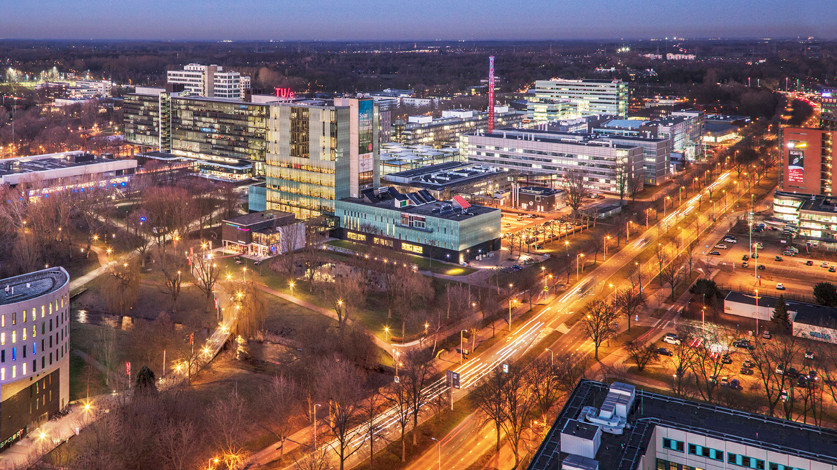


Advancements in low-temperature ammonia decomposition on Cs-Ru/CeO₂ catalysts: a kinetic study
Gaetano Anello , Roberto Fiorillo, Giulia De Felice, Fausto Gallucci
Shanghai, China - September 23 - 26, 2024
.

Slide 2
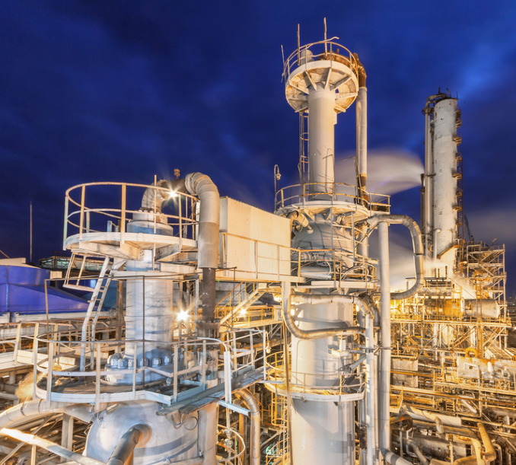

Overview
Hydrogen & Ammonia
Process Intensification
Catalysts for NH₃ decomposition
Results
Conclusions and Outlooks

Slide 3








Introduction
Hydrogen as flagship of the Energy Transition
GREY
HYDROGEN
BLUE
HYDROGEN
TURQUOISE
HYDROGEN
GREEN
HYDROGEN
Source Process
Steam Reforming
Gasification
Steam Reforming
Gasification
(carbon capture ≈90%)
Pyrolysis
Electrolysis
Methane
Coal
Methane
Coal
Methane
Renewable
electricity
ENERGY TRANSITION
Fossil Fuels
Green
H₂
Fossil Fuels
H₂
[01] Kovac A. et al. – Hydrogen in energy transition: A review – International Journal of Hydrogen Energy, v. 46, 10016-10035 (2021)
[02] Capurso T. et al. – Perspective of the role of hydrogen in the 21st century energy transition – Energy Conversion and Management, v. 251, 114898 (2022)

Slide 4
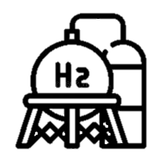



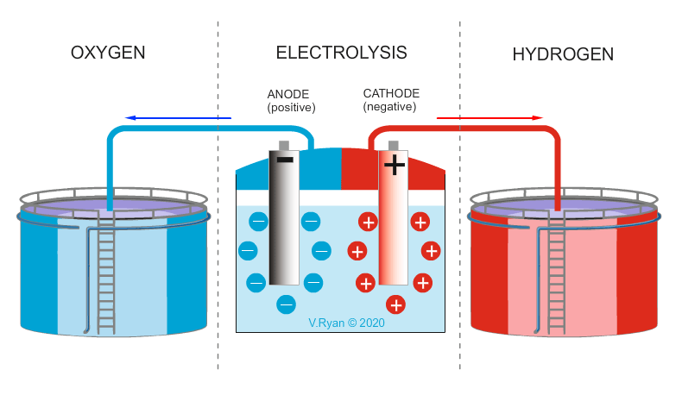
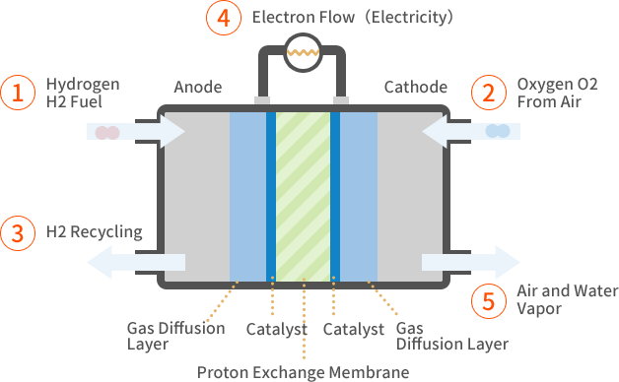


Hydrogen
Renewable green hydrogen cycle
Storage & Distribution
H₂
Wide flammability range
Low ignition energy
H₂ Production
Uses
O₂ Electrolysis H₂
O₂
H₂
H₂ O
H₂ engines and Fuel Cells
H₂O

Slide 5
Hydrogen
Storage solutions
H₂
Storage Solutions
Physical-based
Chemical-based
Cold/Cryo-Compressed Gas
Compressed Gas
Liquid H₂
Carbon Materials
Zeolites
Metal Organic Framework
Glass Capillary arrays
Ammonia
Metal Hydrides
Carbohydrate
ADVANTAGES
High hydrogen density
DISADVANTAGES
Trace of NH₃ in the H₂ after the decomposition
Relatively easy cracking
No CO₂ emissions.
Process deeply limited by thermodynamics
Toxicity of ammonia
Well-developed storage&distribution infrastructure
[03] [https://www.energy.gov/eere/fuelcells/hydrogen-storage (Accessed on 09.10.2023)
[04] Morandi R. and Groth K. M. – Hydrogen storage and delivery: Review of the state of the art technologies and risk and reliability analysis – International Journal of Hydrogen Energy, v. 44, 12254-12269 (2019)

Slide 6
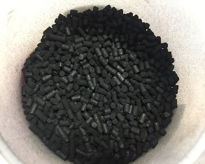

Ammonia decomposition
Conventional system
H₂ + N₂
$2{NH}_{3}⇄$ $N_{2}+3H_{2}$
H₂ / N₂ separation unit
H₂
Off-gases
NH₃
CATALYTIC REACTOR
Reaction unit working at
High temperature and low pressure.
[05] Cechetto V. et al. – Advances and Perspectives of H₂ Production from NH₃ Decomposition in Membrane Reactors – Energy Fuels v. 37, 10775-10798 (2023)

Slide 7
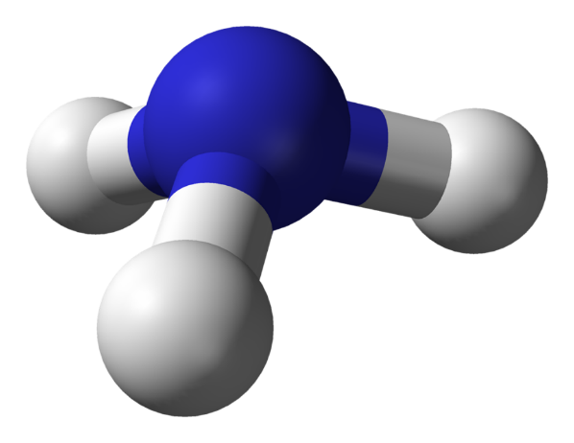

Ammonia decomposition
Process intensification: Catalytic Membrane Reactor
Permeate: H₂
$2{NH}_{3}⇄$ $N_{2}+3H_{2}$
Retentate: N₂
NH₃
CATALYTIC MEMBRANE REACTOR
NH₃ decomposition and
high-purity H₂ separation
are simultaneously performed.

Slide 8
Catalysts for ammonia decomposition
Ruthenium as active phase
Ruthenium-based catalysts are employed for ammonia decomposition due to their excellent activity at lower temperatures. Therefore, to efficiently use this precious resource, developing Ru-based catalysts with low loading, high activity and high stability has become a research hotspot.
[06] http://www.statista.com/statistics/1046426/ruthenium-price/ (Accessed on 12.06.2024)

Slide 9
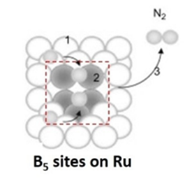
Catalysts for ammonia decomposition
Catalytic formulation: Ruthenium and B5-sites
B5-type surface sites can be responsible for the specific activity of Ru catalysts. B5-type site consists of an arrangement of three Ru atoms in one layer and two further Ru in the layer directly above this at a monoatomic step on an Ru(0001) terrace .
N₂
1
N
2
3
N
Ru B5-site
[07] Kim H. et al. – Ammonia decomposition over Ru catalysts supported on alumina with different crystalline phases – Catalysis Today, v. 411–412, 2023, 113817
[08] Dahl S. et al. – Role of steps in N2 activation on Ru(0001) – Physical Review Letters, v. 83 (1999)

Slide 10

















Catalysts for ammonia decomposition
Catalytic formulation: Ruthenium and B5-sites
Moreover, ruthenium clusters with 1.8 – 3.5 nm diameter are believed to bear B5-site.
[07] Kim H. et al. – Ammonia decomposition over Ru catalysts supported on alumina with different crystalline phases – Catalysis Today, v. 411–412, 2023, 113817
[08] Dahl S. et al. – Role of steps in N2 activation on Ru(0001) – Physical Review Letters, v. 83 (1999)

Slide 11
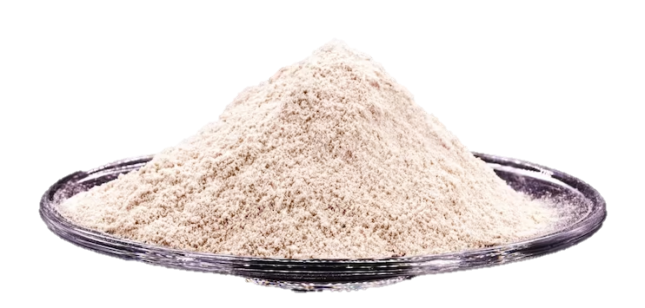
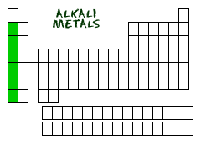
Catalysts for ammonia decomposition
Catalytic formulation: Support and promotor
Ceria enables electron donation from partially reduced cerium atoms to metallic ruthenium.
Alkali metals can ensure the Ru-surface reconstruction and influence the surface morphology of the catalyst.
Alkali Metals
The surfaces exposed could provide new active B5-sites and, at the same time, they are more resistant to poisoning by hydrogen.
Cs
Cesium can promote the electron donation from metallic ruthenium to the N₂ triple bond.
[09] Aika K. et al. – Preparation and Characterization of Chlorine-Free Ruthenium Catalysts and the Promoter Effect in Ammonia Synthesis – Journal of Catalysis, v. 136, 126-140 (1992)
[10] Javaid R. et al. – Effect of reaction conditions and surface characteristics of Ru/CeO2 on catalytic performance for NH₃ synthesis as a clean fuel – International Journal of Hydrogen Energy, v. 46, 18107-18115 (2021)
[11] Linag C. et al. – Graphitic Nanofilaments as Novel Support of Ru–Ba Catalysts for Ammonia Synthesis - Journal of Catalysis, v. 211, 278-282 (2002)
[12] Javaid R. et al. – Influence of Reaction Conditions and Promoting Role of Ammonia Produced at Higher Temperature Conditions in Its Synthesis Process over Cs-Ru/MgO Catalyst – Chemistry Select, v. 4, 22184-2224 (2019)
[13] Zheng J. et al. – Efficient Non-dissociative Activation of Dinitrogen to Ammonia over Lithium-Promoted Ruthenium Nanoparticles at Low Pressure - Angewandte Chemie International Edition, v. 58, 17335-17341 (2019)

Slide 12
Catalysts for ammonia decomposition
Cluster size and synthesis methods
 | Synthesis method | Cluster size | Reference
 |  | (nm)
 | Impregnation | 2 - 30 | [14],[15]
 | Co-precipitation | 2 - 6 | [16],[17]
 | Polyol Reduction | 1 - 5 | [18],[19]
SIMPLE
SINGLE-STEP PROCESS
ALLOWS PREPARATION OF NANOSTRUCTURED POWDERS
[14] Hansen T. W. et al. – Support effect and active sites on promoted ruthenium catalysts for ammonia synthesis – Catalysis Letters, v. 84, 7-12 (2002)
[15] Liu J. et al. – Ru-nanoparticles embedded in mesoporous carbon microfibers: preparation, characterization and catalytic properties in the hydrogenation of D-glucose – Physical Chemistry Chemical Physics, v. 13, 3758-3763 (2010)
[16] Zhang L. et al. – Highly efficient Ru/Sm₂O₃-CeO₂ catalyst for ammonia synthesis – Catalysis Communications – v. 15, 23-26 (2011)
[17] Komvokis V. G. et al. – Catalytic decomposition of N₂O over highly active supported Ru nanoparticles (≤3nm) prepared by chemical reduction with ethylene glycol – Applied Catalysis B: Environmental, v. 103, 62-71 (2011)
[18] Miyazaki A. et al. – Preparation of Ru nanoparticles supported on γ-Al2O3 and its novel catalytic activity for ammonia synthesis – Journal of Catalysis, v. 204, 364-371 (1998)
[19] Fievet F. et al. – Preparing Monodisperse Metal Powders in Micrometer and Submicrometer Sizes by the Polyol Process, MRS Bulletin, v. 14, 29-34 (1989)

Slide 13



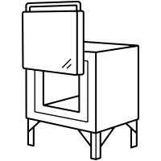


Catalysts for ammonia decomposition
Polyol Reduction Method
ROLE OF ETHYLENE GLYCOL:
Solvent for the starting compound
Reducing agent for the metal species
Crystal growth medium for metal particles
Metal precursors
Polyhydric Alcohol
Catalyst
KOH solution
FORMATION OF METALLIC PARTICLES
HEATING
TO REFLUX
IONS REMOVAL
CLEANING
CALCINATION
[19] Fievet F. et al. – Preparing Monodisperse Metal Powders in Micrometer and Submicrometer Sizes by the Polyol Process, MRS Bulletin, v. 14, 29-34 (1989)
[20] Komarneni S. et al. – Microwave-Polyol Process for Pt and Ag Nanoparticles, Langmuir, v. 18, 5959-5962 (2002)
[21] Saadatjou N. et al. – Ruthenium Nanocatalysts for Ammonia Synthesis – A Review, Chemical Engineering Communications, v. 202, 420-448 (2015)
[22] Fiévet F. et al. – The polyol process: a unique method for easy access to metal nanoparticles with tailored sizes, shapes and compositions – Royal Society of Chemistry, v. 47, 5187-5233 (2018)

Slide 14
Catalysts for ammonia decomposition
Catalysts list
 | Catalyst | Cs loading | Ru loading | Cs/Ru ratio
 |  | wt% | wt% | w/w
 | 3RuCeO₂ | - | 3 | -
 | 5RuCeO₂ | - | 5 | -
 | 7RuCeO₂ | - | 7 | -
 | 2Cs-5RuCeO₂ | 2 | 5 | 0.4
 | 10Cs-5RuCeO₂ | 10 | 5 | 2
_{Ru-loading investigation}
_{Cs/Ru mass ratio investigation}

Slide 15
Experimental Setup
Activity tests
Amount of catalyst: 1 g
Amount of Silicon Carbide: 5 g
Particle Size Distribution: 150 – 250 μm
Reactor Inner Diameter: 10 mm
Reactor Length: ~ 50 mm
GHSV: 6 000 – 30 000 Nml g_{cat} h⁻¹

Slide 16
Results
Activity tests: Ruthenium loading investigation
P = 1 bar, GHSV = 6 000 Nml g_{cat}⁻¹ h⁻¹
Thermal decomposition: X_{NH3} < 2% (@1 bar, 450°C)

Slide 17
Results
Activity tests: Cs/Ru ratio investigation
P = 1 bar, GHSV = 6 000 Nml g_{cat}⁻¹ h⁻¹
Thermal decomposition: X_{NH3} < 2% (@1 bar, 450°C)

Slide 18
Results
Literature comparison
This superior performance can be primarily attributed to several factors:
The synthesis technique used
The optimization of ruthenium loading for the specific support
The synergistic effect between the support and the active phase

Slide 19
Results
Long term tests employing 2Cs-5Ru/CeO₂
P = 1 bar, GHSV = 6 000 Nml g_{cat}⁻¹ h⁻¹

Slide 20
Characterization
X-Ray Diffractometry analysis
Main peaks' location for cubic lattice of CeO₂ : 28.5° , 33.1° , 47.5° , 56.4° , 58.2° , 69.5° , 76.0° , 77.9°
[23] Peng Z. et al. – Uniform dispersion of ultrafine ruthenium nanoparticles on nano-cube ceria as efficient catalysts for hydrogen production from ammonia-borane hydrolysis, Sustain. Energy Fuels, v. 7, 821-831 (2022)

Slide 21
Characterization
H2 – Temperature Programmed Reduction

Slide 22
Characterization
XPS deconvoluted spectra Cerium 3d
5Ru/ CeO₂
_{[Ce}3+_{] = 39%}
2Cs-5Ru/ CeO₂
_{[Ce}3+_{]= 44%}
[24] Lin B. et al. – Effect of ceria morphology on the catalytic activity of Co/CeO2 catalyst for ammonia synthesis – Catalysis Communication v. 101, 15-19 (2017)

Slide 23
Characterization
CO – Pulse Chemisorption
2Cs-5Ru/ CeO₂

Slide 24
Results
Pressure influence
GHSV = 6 000 Nml g_{cat}⁻¹ h⁻¹

Slide 25

Conclusions
Ru-based-CeO₂-supported catalysts where successfully synthesized via PRM.
The non-promoted catalyst (5Ru/CeO₂) allowed an ammonia conversion reaching the equilibrium already between 375 and 400°C (1 bar, 6000 Nml g_{cat}⁻¹ h⁻¹).
The addition of cesium (2Cs-5Ru/CeO₂) to the catalytic formulation resulted in an increase of ammonia conversion by 33% ( 350°C, 1 bar, 6000 Nml g_{cat}⁻¹ h⁻¹).
The overall conversion decreased less then 1% over 1000 hours of test at 400°C, proving the high stability of the synthesized catalyst over time.
This work has received funding by the European Commission under the grant agreement 101138466 (Apolo project). Views and opinions expressed are however those of the author(s) only and do not necessarily reflect those of the European Union. Neither the European Union nor the granting authority can be held responsible for them.

Slide 26


Thank you for your attention! Any question?
CONTACT US

